Slide 1
Increased Intracranial Pressure
Monro-Kellie hypothesis: because of limited space in the skull, an increase in any one skull component—brain tissue, blood, or CSF—necessitates a change in the volume of another
Compensation to maintain a normal ICP of 10 to 20 mm Hg is normally accomplished by shifting or displacing CSF
With disease or injury, ICP may increase
Increased ICP decreases cerebral perfusion, causes ischemia, cell death, and (further) edema
Notes:
Amy
ICP can be caused by traumatic closed head injury, brain tumor, subarachnoid or other cranial hemorrhage, toxic, bacterial, and viral encephalopathies (hepatic, meningitis, herpes viral lesions).
Normal compensation for increased ICP is elevation of MAP, which increases cerebral perfusion, decreased CO2, which decreases blood volume in the brain, decreased CSF.

Slide 2
ICP and CPP
Normal ICP is 10 to 20 mmHg
CCP (cerebral perfusion pressure) is closely linked to ICP
CCP = MAP (mean arterial pressure) – ICP
Normal CCP is 70 to 100
A CCP of less than 50 results in permanent neuralgic damage
Notes:
Amy

Slide 3
Early Signs of ICP
The earliest sign of increasing ICP is a change in LOC.
Slowing of speech and delay in response to verbal suggestions are other early indicators.
Notes:
Angie
Nursing management focuses on detecting early signs of increasing ICP, because medical interventions are usually ineffective once later signs have developed. Frequent neurologic assessments, documentation, and analysis of trends will reveal the subtle changes that may indicate increasing ICP.

Slide 4
Detecting Early Indications of Increasing ICP
Disorientation, restlessness, increasing agitation, increased respiratory effort (Kussmaul breathing), purposeless movements, and mental confusion.
Pupillary changes and impaired extraocular movements.
Weakness in one extremity or on one side of the body.
Headache that is constant, increasing in intensity, and aggravated by movement or straining.
Notes:
Angie
First bullet- these are early clinical indications of increasing ICP because the brain cells responsible for cognition are extremely sensitive to decreased oxygenation. Kussmaul breathing is rapid deep breathing pattern that is a compensatory mechanism. CO2 is blown off or ventilated causing vasoconstriction, thereby reducing blood volume intercranially, reducing ICP.
Second bullet- these occur as the increasing pressure displaces the brain against the oculomotor and optic nerves (cranial nerves II, III, IV, and VI), which arise from the midbrain and brain stem. Pupillary reaction will become sluggish and may appear vertically ovoid in shape. The impaired extraocular range of motion will be evident upon assessment of the 6 cardinal field of gaze
Third bullet- this occurs as increasing ICP compresses the pyramidal tracts.
Fourth bullet- this occurs as increasing ICP causes pressure and stretching of venous and arterial vessels in the base of the brain.

Slide 5
Other manifestations include:
Behavior changes
Seizures
Nausea and Vomiting
Lethargy
Notes:
Angie

Slide 6
↑ in ICP is a medical emergency
Treatment should be initiated immediately
Notes:
Michelle

Slide 7
Ways to relieve an increase in ICP
Decrease Cerebral Edema
  Mannitol
  Fluid Restrictions
    Assess BP, skin turgor, mucous membranes, urine output & osmolality
    IV Fluids prescribed – slow to moderate rate
    Oral hygiene b/c of dehydration
Maintaining Cerebral Perfusion
  Dobutrex
  Levophed
  Keep head in a midline position
  Avoid extreme hip flexion
  Avoid the Valsalva maneuver
Notes:
Michelle
Decrease cerebral edema
Mannitol – a diuretic used to dehydrate the brain tissue
Need to catheterize patient to monitor output to manage the diuresis (increased production of urine) that occurs b/c of the mannitol.
Monitor hydration status b/c of the diuretic with serum osmolality labs
Fluid Restriction
Leads to dehydration and hemoconcentration (increase in blood cells due to loss of plasma or water from the bloodstream). This draws fluid across the osmotic gradient and decreases edema
BP, skin turgor, mucous membranes, urine output, and osmolality are assessed. IV fluids prescribed and administered at a slow to moderate rate to prevent overhydration and too rapid of administration.
Urine output of more than 250 ml/hr for 2 consecutive hours may indicate onset of diabetes insipidus
Oral hygiene – rinse mouth frequently, lubricating the lips, removing encrustations.
Maintaining cerebral perfusion
Dobutrex & Levophed – used to improve cardiac output which will perfuse the brain more efficiently. Effectiveness is shown in the Cerebral Perfusion Pressure (CPP) which should be around 70 mm Hg. Low CPP indicates that the cardiac output is insufficient to maintain adequate cerebral perfusion.
Keep head in a midline position with use of cervical collar if necessary. Extreme rotation & flexion of the neck can increase ICP b/c of compression on the jugular veins.
Avoid extreme hip flexion – causes intra-abdominal and intra-thoracic pressures to rise which can increase ICP. Any change in position can affect ICP. If that occurs, anytime there is a change in position of the patient, their head is held during those times to lessen the chance of an increase in ICP. Can also tell patient to exhale on moving to open the glottis to avoid the Valsalva
Avoid the Valsalva maneuver – stool softeners, high fiber diet, changing position slowly

Slide 8
Ways to relieve an increase in ICP
Reducing CSF and Intracranial Blood Volume
  Drain CSF
    Aseptic technique and assess for signs of infection
  Hyperventilation – as a last resort
Controlling Fever
  Antipyretic medications
  Hypothermia blanket
  Avoid shivering in the patient
  Removing all bedding over the patient (except for a light sheet)
  Giving cool sponge baths and an electric fan to facilitate cooling
  Monitor temperature frequently – monitor response to therapy and to prevent excess decrease in temperature and shivering
Notes:
Michelle
Reducing CSF and intracranial blood volume
Drain CSF (via ventriculostomy) – this is performed often because this can greatly reduce ICP and restore CPP. Need to be careful with this because too much drainage can cause a collapse of the ventricles and herniation
Use aseptic technique when managing the system and draining the bag. Check system for loose connections. Observe character of drainage and report cloudiness or blood. Monitor for signs of meningitis: fever, chills, nuchal (neck) rigidity, persistent headache.
Hyperventilation – was previously used with patients with increased ICP, but research has shown that a reduction in PaCO2 can result in hypoxia & ischemia. This is an option only for those whose pressure is not responsive to other therapies. If used monitor PaCO2 and maintain at 30-35 mm Hg
Controlling Fever – important because increased temperature increases cerebral metabolism and the rate which edema forms. The brain temperature is 1 – 1.5 degrees high than the body’s core temperature, therefore with ICP, you should keep the patient at a lower than normal temperature (hyperthermia)
Antipyretic medications
Hypothermia blanket
Avoid shivering in the patient – associated with increased O2 consumption, increased levels of circulating catecholamines (released b/c of stress – examples are epinephrine, norepinephrine and dopamine), and increased vasoconstriction. (wrapping the hands and feet in warmed blankets is often used as nursing intervention to control shivering)
Removing all bedding over the patient (except for a light sheet)
Giving cool sponge baths and an electric fan to facilitate cooling
Monitor temperature frequently – monitor response to therapy and to prevent excess decrease in temperature and shivering

Slide 9
Ways to relieve an increase in ICP
Maintaining Oxygenation
  Maintain a patent airway
  Discourage coughing and straining
  Auscultate lungs every 8 hours
  Monitor ABGs and Pulse oxymetry
  Optimize hemoglobin saturation
Reducing Metabolic Demands
  High doses of barbiturates
  Paralytics
Notes:
Michelle
Maintaining Oxygenation – do this to ensure that systemic oxygenation remains optimal
Maintain a patent airway – need to suction secretions carefully b/c you can get transient increases in ICP with suctioning. Hyperoxygenate patient before and after suctioning. Suctioning should not last more than 15 seconds
Discourage coughing and straining
Auscultate lungs at least every 8 hours
Elevate the head of the bed 30 degrees
Monitor ABG and Pulse Oxymetry
Optimize hemoglobin saturation – helps to provide more oxygen at the cellular level
Reducing metabolic demands
High doses of barbiturates if patient unresponsive to conventional treatment. Mechanism of treatment to decrease ICP is unknown, but the comatose state is thought to protect the brain by reducing metabolic requirements which provides some cerebral protection.
Propofol – (the book says this is a paralyzing agent, but actually this drug is a sedative, not a paralyzing agent, even though it is a paralyzing agent that is indicated in this section ). Patient is unable to move which decreases metabolic demands which results in a decrease in cerebral oxygen demand. Patient will be unable to respond to pain, so sedation and analgesia is also used.

Slide 10
Due to the use of paralyzing agents patient will require:
Continuous cardiac monitoring
Endotracheal intubation
Mechanical ventilation
ICP monitoring
Arterial pressure monitoring
Notes:
Michelle
Due to the paralyzing agents used, patient will require:
Continuous cardiac monitoring
BP, HR, RR, Pulse oxymetry
Endotracheal intubation
Mechanical ventilation
ICP monitoring
Continuous arterial blood pressure monitoring
Paralytic serum levels or percutaneous nerve stimulation (to check level of paralysis)
Also unable to assess neurological functioning with these medications: continuous EEG monitoring.

Slide 11
Monitoring ICP
Ventriculostomy:
AKA Ventricular Catheter Monitoring Device
Fine bore catheter is inserted into the non-dominant hemisphere of the brain
Catheter connected to a transducer that monitors the ICP and Records data-Oscillator scope
Allows for ICP relief by allowing for CSF release thus relieving intercranial HTN
Intraventricular Med Administration access
Air or contrast administration for Ventriculography
Notes:
Steve,
Notes Slide I
Purposes of:
Recognize increases in Pressure at an early stage before brain damage occurs. Jugular Venous bulbs with measure O2 levels can be an early warning tool before a surge in ICP.
Provide an access site for monitoring CSF pressure and easy access to release fluid and a way to evaluate treatment progression.

Slide 12
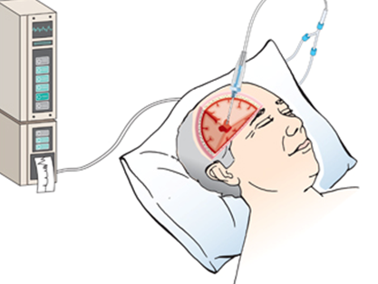
Ventriculostomy with fiber optic transducer-tipped device
Complication of Ventriculostomy:
Infection
Meningitis
Ventricular Collapse
Occlusion of catheter device by brain or blood materials
Problems with monitoring system
Notes:
Steve

Slide 13
Monitoring ICP (continued)
Subarachnoid Screw or Bolt:
Screw or bolt is a hollow screw that is inserted through a hole drilled in the skull and through a hole cut in the dura mater in to the subarachnoid space.
  Hollow screw avoids complications from brain shifting
  Doesn’t require ventricular puncture
  Infection & clogging screw with brain matter affecting readings
Notes:
Steve
Subarachnoid Screw type=Occlusion by clot or brain tissue which affects pressure readings

Slide 14
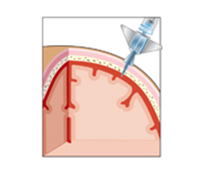
Subarachnoid screw or bolt
Notes:
Steve

Slide 15
Monitoring ICP (continued)
Epidural Sensor:
Epidural Device is placed through a burr hole drilled in the skull, just over the epidural covering. Uses pneumatic pressure to signal an alarm for pressure abnormalities.
  Epidural lining is not perforated, thus less invasive & less infection
  Cannot relieve excess CSF.
Notes:
Steve
Epidural Monitor/Sensor=Advantage is that abnormal pressures cause an alarm to signal & has had less monitoring & less infection complications.

Slide 16
Monitoring ICP (continued)
Fiber Optic Sensor
Fiber Optic device can be inserted into the ventricle, subarachnoid and subdural space. Mini-Transducer converts ICP readings into electronic digital monitoring
  When inserted in to the ventricle can allow for CSF withdrawal.
Notes:
Steve

Slide 17
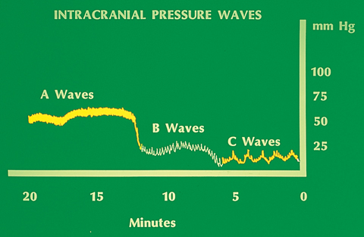
Trending ICP Values
ICP Waves:
A Waves-Can last 5-20 minutes with amplitudes between 50-100 mmHg
B Waves-30 seconds to 2 minutes with amplitudes up to 50 mmHg
C Waves – Occur up 6 times a minute with amplitudes up to 25 mmHg
Notes:
Steve
A Waves reflect the need for emergent intervention because they represent an increase in amplitude and frequency and can signify cerebral ischemia and brain damage. A waves may be observed before overt signs are seen (late manifestations of increased ICP’s).
B waves, while not as emergent, still require intervention. They can be seen in patients with increased intracranial HTN and may prelude the A Wave type.
C Waves - The clinical significance of the C waves is unknown; it is thought they are related to normal change to systemic arterial pressure and ventilation, therefore no intervention is indicated.

Slide 18
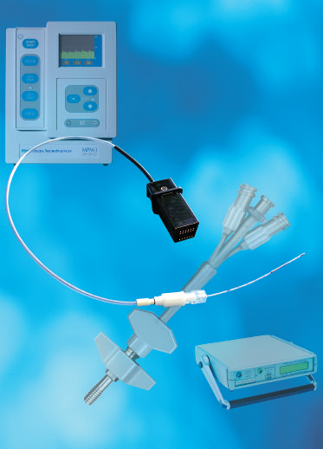
New Trends in Neuro Monitoring
Licox Catheter
  A 3 in 1 white matter catheter that measures ICP, Temperature, and end capillary tissue oxygen level.
  Gives real time feed back of ICP management, guiding therapy and oxygenation of tissue at risk in the cerebrum.
  The temperature probe can be replaced with a microdialysis probe
Picture from INTREGA website: http://www.integra-is.com/PDFs/licox/NS327%20ICP%20Catheter%20w%20IMC%20Bolt.pdf.
Notes:
Amy
Catheter is placed in the penumbra of primary injury. This is the edematous area around the primary injury that is at risk for further ischemic injury without proper oxygenation.
The microdialysis probe measures glutamate, lactate, pyruvate, and glucose. These are substances that reflect metabolic function of the brain, which would show signs of anaerobic respiration before a drop PBTO2

Slide 19
Late Manifestations of Increased ICP
Further deterioration of LOC; stupor to coma
Decreasing level of responsiveness & consciousness
Reacting only to loud or painful stimuli
Deterioration of motor function; abnormal motor responses
  Hemiplegia, decortications, decerebration, or flaccidity may occur (abnormal posturing)
Notes:
Suzanne

Slide 20
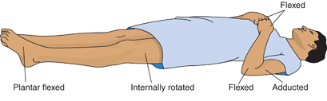
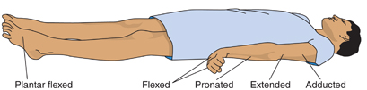
Decorticate Posturing
Decerebrate Posturing
Notes:
Suzanne

Slide 21
Late Manifestations of Increased ICP cont.
Alterations in vital signs
  Increase in systolic blood pressure
  Widening of pulse pressure
  Slowing of the heart rate; pulse may fluctuate rapidly from tachycardia to bradycardia
  Increase in temperature
  Cushing’s Triad: bradycardia, hypertension, & bradypnea
    Immediate intervention required to prevent herniation of brain stem & occlusion of blood flow
    Cessation of cerebral blood flow results in cerebral ischemia, infarction, & brain death
Notes:
Suzanne

Slide 22
Late Manifestations of Increased ICP cont.
Visual changes; pupillary changes reflecting pressure on optic/oculomotor nerves
  Pupils decrease or increase in size or become unequal
  Lack of conjugate eye movement
  Papilledema
Projectile vomiting may occur with increased pressure on the reflex center in the medulla
Loss of brain stem reflexes, including pupillary, corneal, gag, & swallowing reflexes
  Loss of reflexes is an ominous sign of approaching brain death
Notes:
Suzanne

Slide 23
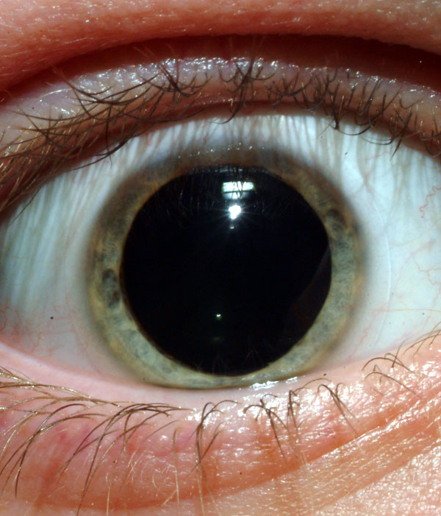
Late Manifestations of Increased ICP cont.
Classic fixed and dilated “blown pupil”
Absence of oculocephalic reflex or “doll’s eye”
Picture: http://images.google.com/imgres?imgurl=http://www.owlnet.rice.edu/~psyc351/Images/DilatedPupil.jpg&imgrefurl=http://www.truthpirates.com/2008_02_01_archive.html&h
=701&w=600&sz=85&hl=en&start=6&usg=__7y-UPnlkgmryZ7jhzG16AFG5c2Y=&tbnid=d-8RDkK4oCFdM:&tbnh=140&tbnw=120&prev=/images%3Fq%3Dblown%2Bpupil%26gb
v%3D2%26hl%3Den Information: http://www.emedmag.com/html/pre/cov/covers/121501.asp
Notes:
Suzanne
The classic fixed and dilated "blown pupil" is a unilateral phenomenon that may occur when a rapidly expanding intracranial mass, including blood from a hemorrhage, is compressing cranial nerve III. It may also represent herniation of the uncus of the temporal lobe.
The oculocephalic and oculovestibular reflexes are tested to evaluate brain stem function and the reticular activating system, respectively. The oculocephalic response, or doll's eye reflex, is a measure of the pontine gaze center. Cervical spine injury must be ruled out before the test maneuver is done. After raising the head of the patient's bed 30°, the clinician rotates the patient's head briskly from side to side. In the normal doll's eye response, both eyes maintain position by moving in the direction opposite that of the rotation. If the eyes stay fixed and rotate with the head, brain stem function is impaired or absent.

Slide 24
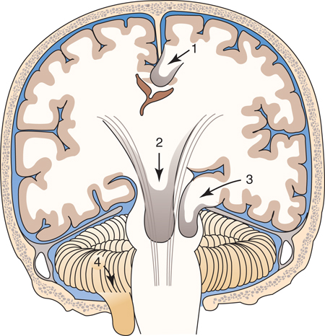
Late Manifestations of Increased ICP cont.
Major complication of Increased ICP - Hernation
(1) Herniation of the cingulate gyrus under the falx cerebri. (2) Central transtentorial herniation. (3) Uncal herniation of the temporal lobe into the tentorial notch. (4) Infratentorial herniation of the cerebral tonsils.
Notes:
Suzanne
Brain stem herniation results from an excessive increase in ICP in which the pressure builds in the cranial vault and the brain tissue presses down on the brain stem. This increasing pressure on the brain stem results in cessation of blood flow to the brain, leading to irreversible brain anoxia and brain death.

Slide 25
Late Manifestations of Increased ICP cont.
Diabetes insipidus is the result of decreased secretion of antidiuretic hormone (ADH).
SIADH is the result of increased secretion of ADH.
All information other than the Licox slide, and ‘blown pupil’ slide is from Brunner & Suddarth’s Textbook of Medical-Surgical Nursing, 11th edition http://thepointeedition.lww.com/pt/re/9780781759786/bookcontent.01269236-11th_Edition-4.htm;jsessionid=JDwGTQLQgQ7mx2GyvpyknRhhvPRV
J2Z6KpkpX2sJTT983RtPFhyL!-985563194!181195629!8091!-1 Information compiled by Stephen Strom, Michelle Harris, Angela Reaves, Suzanne Finch, and Amanda King
Notes:
Suzanne
Diabetes insipidus is the result of decreased secretion of antidiuretic hormone (ADH). The patient has excessive urine output, decreased urine osmolality, and serum hyperosmolarity
SIADH is the result of increased secretion of ADH. The patient becomes volume-overloaded, urine output diminishes, and serum sodium concentration becomes dilute.

